Slide 1

PID Controllers
By Luke McGill
Notes:
Good afternoon,
Today I will be talking about PID controllers.

Slide 2
Table of Contents
Introduction
History
Theory
Utilization
Conclusion
Questions
Notes:
First I will give a brief introduction of PID controllers.
I will then cover the history, theory, utilization before I conclude.
Then there will be some time at the end for questions.

Slide 3
Introduction
A control system is a set of mechanical or electronic devices that regulates other devices or systems by way of control loops.
Control systems are used to enhance production, efficiency and safety
PID is type of closed loop controller
Notes:
At its core, is a regulator and control device.
PID stands for Proportional, Integral, and Derivative. I will cover these terms more in depthly in the theory section.
A PID control is a control loop mechanism employing feedback that is widely used in industrial control systems and a variety of other applications requiring continuously modulated control.
They can be mechanical or electrical, but typically they are computerized.
Control systems are used to enhance production, efficiency, and safety.
PID is a type of closed loop controller.

Slide 4
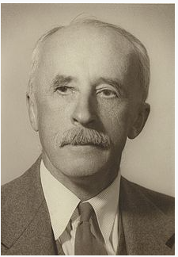
History
1922
Nicolas Minorsky
Theoretical analysis and first proposed application
1933
Taylor Instrument Company
First pneumatic controller with a fully tunable proportional component
1940
Taylor Instrument Company
Developed the first PID pneumatic controller with a derivative action
1942
Ziegler and Nichols tuning rules were introduced so that engineers were able to find and set the appropriate parameters of PID controllers
Notes:
In 1922, Nicolas Minorsky, pictured on the slide, performed theoretical analysis for the PID concept. His first proposed application was steering a US Navy ship.
In 1933, The Taylor Instrument Company made the first pneumatic controller with a fully tunable proportional component.
In 1940, The TIC made the first full PID controller with derivative action.
In 1942, the Zeigler and Nichols tuning rules were introduced so that engineers were able to find and set the appropriate parameters of PID controllers, which was vitally important.
Finally, in the 1950s, automatic PID controllers were widely adopted for industrial use.
This is an image of a pneumatic controller to give you an idea of what the older ones look like.

Slide 5
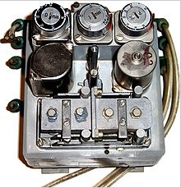
History cont.
1950s
Automatic PID controllers were widely adopted for industrial use
Notes:
Minorsky Steering US Navy ship

Slide 6
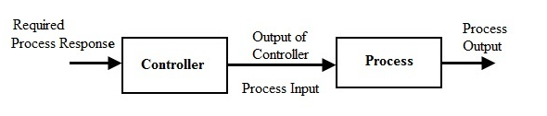
Theory
Open loop control system
Notes:
This is an open loop control system. A reference signal is given to the controller, which outputs to the process, which is the block containing the process and actuation.
These systems are very simple, but they are very inaccurate and the performance is often not good enough to meet system requirements.

Slide 7
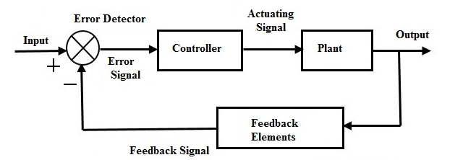
Theory cont.
Closed loop control system
Notes:
This is a closed loop control system.
The main difference is that the output signal is fed back to the input. Now the controller can see if the measured output meets the desired output.

Slide 8
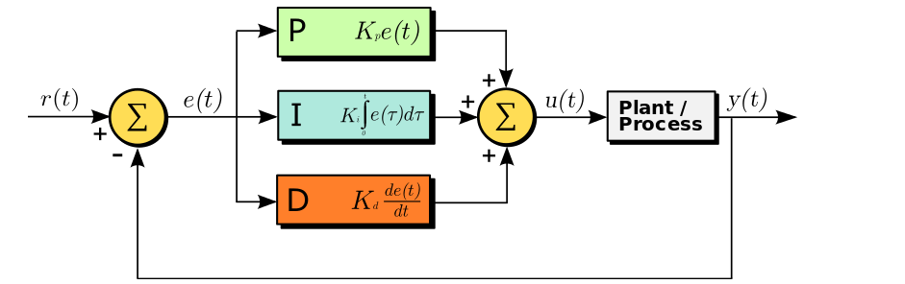
Theory cont.
The PID compares desired output with measured output
e(t) is called the error signal
e(t) = r(t) - y(t)
Notes:
This is the control diagram of the PID controller. Notice the three terms: P,I,and D.
e(t) is called the error signal. It is calculated by subtracting the measured signal from the set point or reference signal.
A perfect system would have an error of 0, which means the output is behaving exactly as desired.

Slide 9
Theory cont.
PID has three terms
Proportional
Integral
Derivative
Notes:
The goal is to have the error signal equal to zero

Slide 10
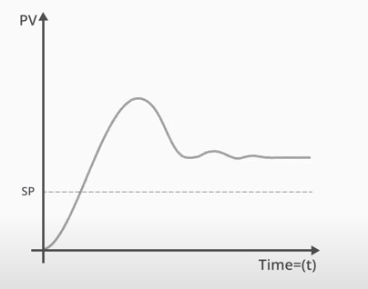
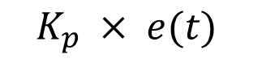
PID Terms
Proportional term K_{p}
Proportional to magnitude of the error signal
$$K_{p} × e(t)$$
Notes:
The first term is called the proportional term. It consists of a constant Kp multiplied by the error signal. This term acts quickly to initially correct the error signal. The bigger the error, the more correction happens. As the error gets smaller, the P term has less effect. This is a plot of how the Proportional term affects the signal.
However, the Proportional term alone will not get you accurately to the set point. As time goes on, the system will reach its steady state. There can also be some oscillation in the system.

Slide 11
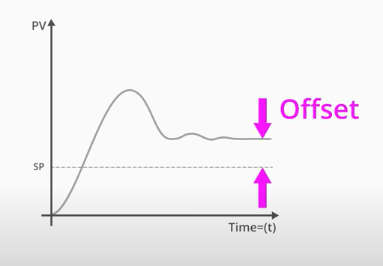
PID Terms
Proportional term K_{p}
Proportional to magnitude of the error signal
$$K_{p} × e(t)$$
Notes:
At steady state, the error signal will have an offset. This is called the steady state error. The P term alone cannot 100% correct this.

Slide 12
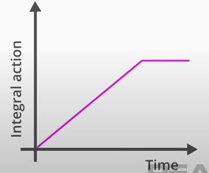
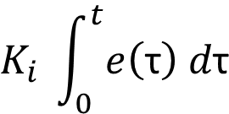
PID Terms
Integral term K_{i}
$$K_{i} \int_{0}^{t}{e\left(\text{τ}\right) d\text{τ}}$$
Notes:
The second term is called the Integral term. It consists of a constant Ki multiplied by the integral of the error signal. The I term is proportional to the duration and magnitude or the error signal.

Slide 13
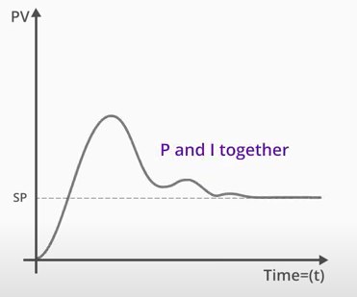
PID Terms
Integral term K_{i}
$$K_{i} \int_{0}^{t}{e\left(\text{τ}\right) d\text{τ}}$$
Notes:
The Integral term smooths the steady state error and any oscillation around the set point. This graph shows the signal when both the P and I terms are applied. As you can see, it does a pretty good job of reducing the error and getting it close to the set point.

Slide 14
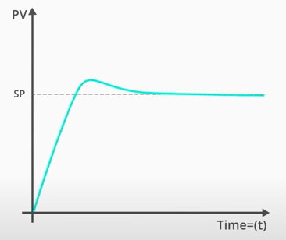
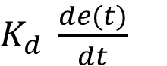
PID Terms
Derivative K_{d}
$K_{d} \frac{de(t)}{dt}$
Notes:
The last term is called the derivative term. It consists of a constant Kd multiplied by the derivative of the error signal. The D term is proportional to the rate of change of the error. The D term does a good job at smoothing quick changes in the system. However, it is highly sensitive to noise, and if improperly tuned, can make the system unstable.

Slide 15
Tuning
Adjust constants K_{p}, K_{i}, K_{d}
PID term tuning can differ vastly between processes and applications
Can be tuned by trial and error, observing output response
Can be time consuming and impractical
Some modern PID controllers have autotuning functionality
Sometimes additional tweaking required
Notes:
This brings me to my next point which is tuning. Each term needs to be individually tuned. This is done by adjusting the multiplied constants: Kp, Ki, and Kd.
If the Kp term is too low, the corrections made by the controller will be too small, and the steady state error will be large. If the Kp term is too large, the system will oscillate around the set point, constantly fighting with itself because the corrections made are too large. It will constantly overshoot and undershoot.
The Ki term also needs to be tuned. This is done to minimize the steady state error, and bring the error signal as close to 0 as possible.
The Kd term needs to be very carefully tuned. This terrn can be troublesome if incorrectly tuned.
The tuning for the PID terms can differ vastly between processes and applications. There are a few methods of tuning. It can be done by trial and error, observing the output response. But this can be time consuming and impractical. Typically, the PID controller will have autotuning functionality. Although, additional tweaks made by a seasoned professional may be required.

Slide 16
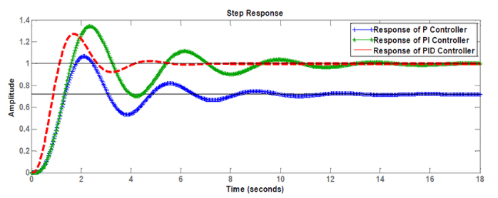
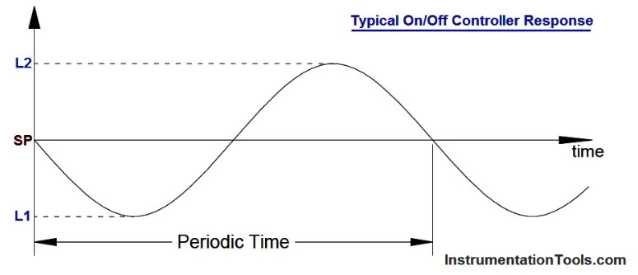
Why choose a PID controller?
Typical PID Controller Response
Notes:
Why would you choose a PID controller?
The simple answer is that they can be very precise.
Another common controller type is called an ON/OFF controller, pictured on the right. You can see this is a very simple control, and the error signal oscillates periodically around the set point. This may be suitable for a thermostat in your home, but that amount of error is not suitable for industrial uses or motion control.
The graph on the left shows the different responses of the PID controller. Explain

Slide 17
Variations
PID not always necessary
P controller
PI controller
Why make a simpler controller?
Easy to implement
Easy to test and troubleshoot
Easy to understand
Can save time and money
Notes:
A full three term PID controller is not always necessary. Some popular variations are a P controller and a PI controller. These controllers only have one or two of the three terms.
Why not use all three terms?
It greatly depends on the system. But they are also easy to implement, easy to test and troubleshoot, easy to understand, and they can save time and money. Engineers will choose the type that makes the most sense for their application.

Slide 18
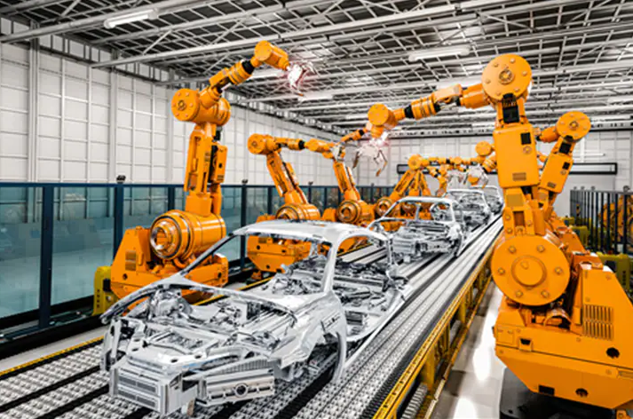
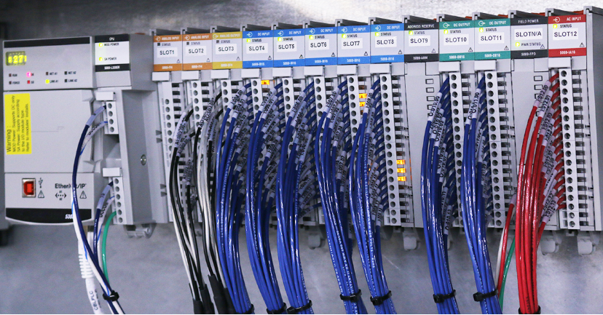
Utilization
Widely used in industry, automation, and manufacturing
Usually digital
Typically integrated in a PLC or DCS
Can still be stand alone devices
Notes:
PID controllers are widely used in industry, automation, and manufacturing, but really they can be used in any control application.
Usually PID controllers are digital and created in program control logic using block commands. Typically they are integrated into a PLC or DCS. However, they can be stand alone devices.

Slide 19
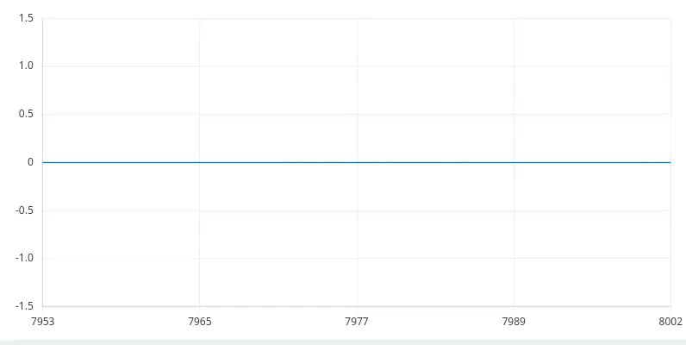
Using PID in Capstone
DC Motor RPM
P Controller
Notes:
My team used a PID controller in our capstone to control the RPMs of our 4 DC motors. DC motors under load will not be precise just given a voltage. The problem we had was that our robot was drifting instead of moving in a straight line.
We made a PI controller, implemented it into our c++ code. This video shows the result of just the P term of the controller. The set point is 100 RPM for this example. The error signal quickly reaches the steady state error, which is about at 85 RPM.

Slide 20

Using PID in Capstone
DC Motor RPM
PI Controller
Notes:
This shows the controller implemented with a P and an I term. The steady state error was corrected and the error signal is pretty close to the set point. There is still some oscillation around the set point, but the values are pretty small.

Slide 21
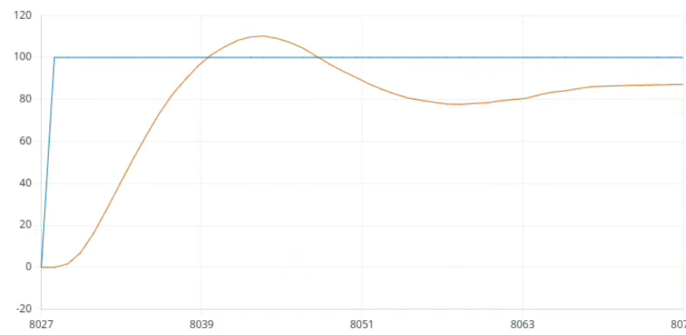
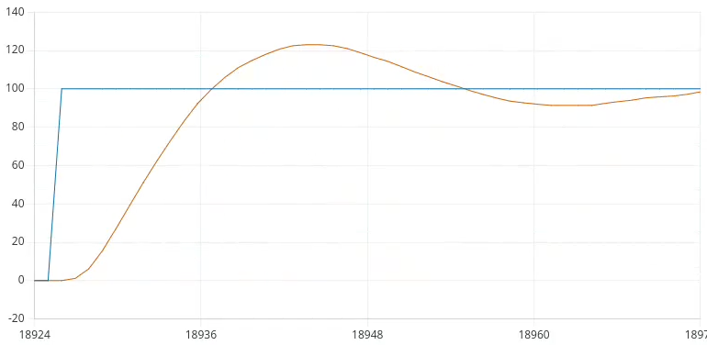
Using PID in Capstone
P Controller
PI Controller
Notes:
Comparing the two graphs, you can see the performance of the DC motor has improved, and it is closer to the set point.
By no means is this controller perfect, but it did greatly help our motor control.

Slide 22
Conclusion
PID controllers are widely used control method
Three terms P, I, D
Can be simple or more sophisticated depending on application
Used heavily in industry, automation, and manufacturing
Notes:
In conclusion, PID controllers are a widely used control method.
There are three terms, PID.
They can be simple or more sophisticated depending on the application.
They are heavily used in industry, automation, and manufacturing.

Slide 23
Works Cited
[1] “Pid Controller,” Wikipedia, 17-Mar-2023. [Online]. Available: https://en.wikipedia.org/wiki/PID_controller#:~:text=A%20proportional%E2%80%93integral%E2%80%93derivative%20controller,continuously%20calculates%20an%20error%20value. [Accessed: 19-Mar-2023].
[2] T. T. Contributor, “What is control system?: Definition from TechTarget,” WhatIs.com, 31-Dec-2017. [Online]. Available: https://www.techtarget.com/whatis/definition/control-system#:~:text=A%20control%20system%20is%20a,of%20industry%20and%20of%20automation. [Accessed: 19-Mar-2023].
[3] O. Engineering, “What is a PID controller?,” https://www.omega.com/en-us/, 28-Sep-2022. [Online]. Available: https://www.omega.com/en-us/resources/pid-controllers. [Accessed: 19-Mar-2023].
[4] E. Staff, “On-off Controller Principle,” Inst Tools, 27-Nov-2018. [Online]. Available: https://instrumentationtools.com/onoff-control-principle/. [Accessed: 19-Mar-2023].
[5] T. Mortenson, “PID controller explained,” The Easiest Way to Learn Industrial Automation, 08-Oct-2022. [Online]. Available: https://realpars.com/pid-controller/. [Accessed: 19-Mar-2023].
[6] Kumar, Vivek & Patra, Ashis. (2016). Analysis of Power Transformer using fuzzy expert and neural network system. [Online] System Response of P,PI& PID Controller tuned with Process Reaction... | Download Scientific Diagram (researchgate.net) [Accessed: 19-Mar-2023].

Slide 24

Questions?

